Slide 1

WeatherMesh
Empowering farmers with data, rewards & insights
Vamshidhar Pratap
Bhavana Ramesh
Lukas Kamm
Pardeep Kumar

Slide 2
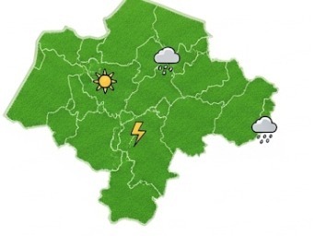
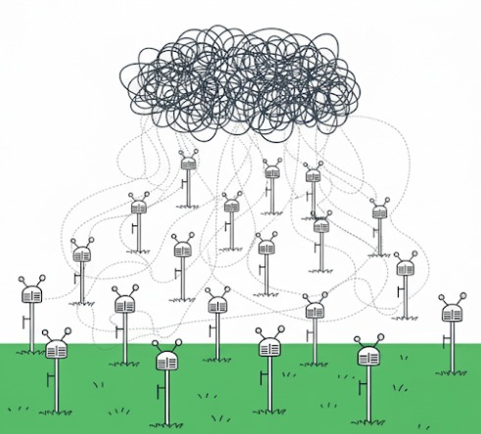
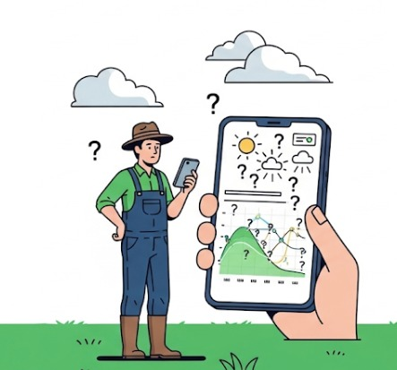
The Problem
A Data Gap in Agriculture
Insufficient reliable weather data
Multiple Unutilized Weather Stations
What comes in exchange with data?
Notes:
How can we monetize data??

Slide 3
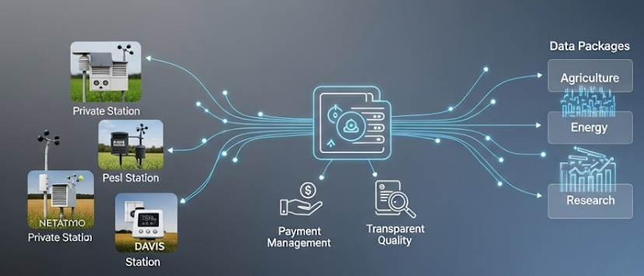
Solution
WeatherMesh: A Decentralized Network
Notes:
A platform that connects diverse weather stations via REST API, standardizes and classifies data by location, quality, and parameters (precipitation, temperature, humidity), and enables micropayments through blockchain or token systems. It offers customizable data packages with daily updates or retroactive access and features a transparent dashboard displaying data sources and trust scores.”

Slide 4
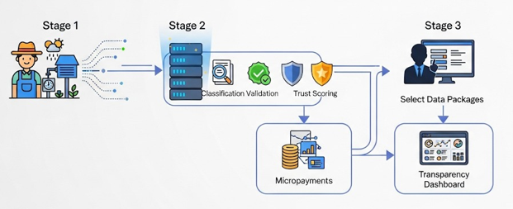
How it works?
Notes:
Data Integration: Farmers share data via API-enabled stations.
Data Validation: Data is classified, validated, and scored for trust.
Real-Time Filters: Users select/customize data packages.
Instant Coin Deposit: Payments handled automatically via micropayments/token system.
Track & Optimize: Dashboard provides full transparency on sources and trust metrics

Slide 5
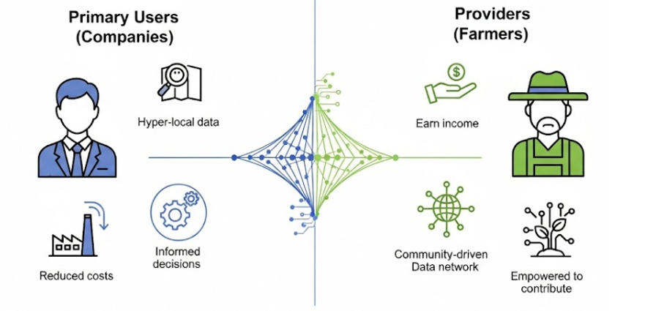
Impact
Borderline Impact:
Beyond data exchange. It reshapes how weather data is valued, accessed, and used across sectors.
Notes:
Primary Users- Insurance companies, agricultural apps, farmers

Slide 6

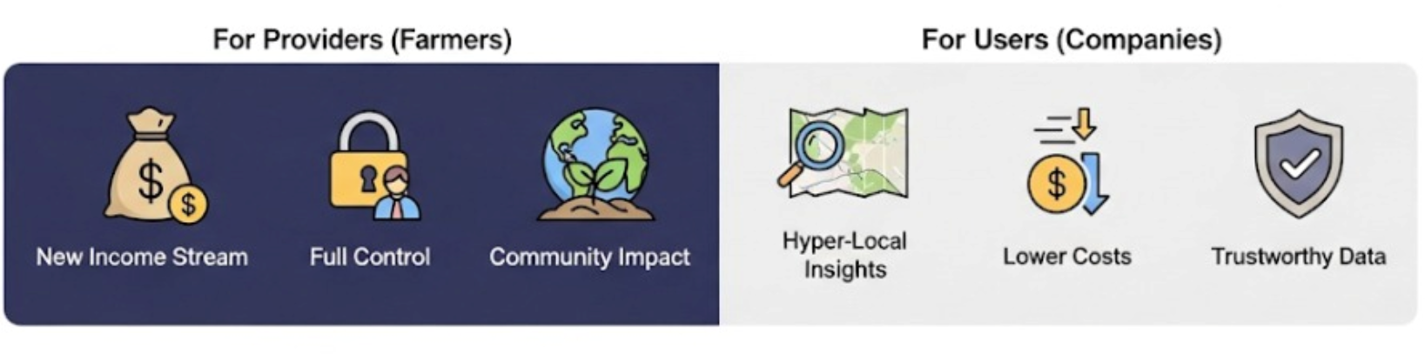
Why us?
For Providers (Farmers)
Tokens redeemable: cash or products(seeds, fertilizer, equipment).
Discounted access to farm forecasts.
Trust scores unlock micro-financing.
For Users(Consumers)
Flexible Pricing
Simplified integration.
Ground-truth data.
Flexible Data packages.

Slide 7
Thank you

